Slide 1

Department of CSE
Course: AI & ML
Course code: 24AD2001A
Topic:
Clustering: K-means, C-means.
Session – 30

Slide 2



AIM OF THE SESSION
The aim of this session is to introduce the concepts, algorithms, and applications of clustering, with a focus on K-means (hard clustering) and Fuzzy C-means (soft clustering), enabling learners to understand the working principles, mathematical formulations, implementation, and evaluation of these methods for real-world data analysis and pattern discovery.
INSTRUCTIONAL OBJECTIVES
This session is designed to:
1. Define clustering and differentiate it from supervised learning methods.
2.Explain the working principles and steps of the K-means algorithm.
LEARNING OUTCOMES
At the end of this session, you should be able to:
1Define and explain the concept of clustering and distinguish between hard and soft clustering approaches.
2. Illustrate the working process of the K-means algorithm with examples.

Slide 3
Objectives
1. To introduce the concept of clustering as an unsupervised learning technique.
2. To explain the step-by-step procedure of the K-means algorithm.
3. To describe the principles and working of Fuzzy C-means clustering.
4.To highlight the differences between hard clustering (K-means) and soft clustering (Fuzzy C-means).
.

Slide 4
Clustering
Clustering is an unsupervised machine learning technique that groups similar data points together into clusters based on their characteristics, without using any labeled data. The objective is to ensure that data points within the same cluster are more similar to each other than to those in different clusters, enabling the discovery of natural groupings and hidden patterns in complex datasets.
Goal: Discover the natural grouping or structure in unlabeled data without predefined categories.
How: Data points are assigned to clusters based on similarity or distance measures.
Similarity Measures: Can include Euclidean distance, cosine similarity or other metrics depending on data type and clustering method.
Output: Each group is assigned a cluster ID, representing shared characteristics within the cluster.

Slide 5
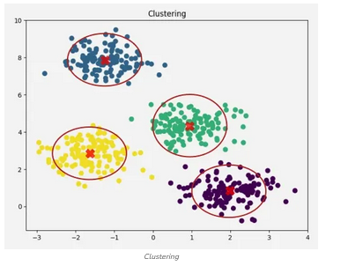
CONTD..

Slide 6
CONTD..
For example, if we have customer purchase data, clustering can group customers with similar shopping habits. These clusters can then be used for targeted marketing, personalized recommendations or customer segmentation.
Types of Clustering
1. Hard Clustering: In hard clustering, each data point strictly belongs to exactly one cluster, no overlap is allowed. This approach assigns a clear membership, making it easier to interpret and use for definitive segmentation tasks.
Example: If clustering customer data into 2 segments, each customer belongs fully to either Cluster 1 or Cluster 2 without partial memberships.
Use cases: Market segmentation, customer grouping, document clustering.

Slide 7
CONTD..
2. Soft Clustering: Soft clustering assigns each data point a probability or degree of membership to multiple clusters simultaneously, allowing data points to partially belong to several groups.
Example: A data point may have a 70% membership in Cluster 1 and 30% in Cluster 2, reflecting uncertainty or overlap in group characteristics.
Use cases: Situations with overlapping class boundaries, fuzzy categories like customer personas or medical diagnosis.
Types of Clustering Methods: Clustering methods can be classified on the basis of how they for clusters,
1. Centroid-based Clustering (Partitioning Methods)
Centroid-based clustering organizes data points around central prototypes called centroids, where each cluster is represented by the mean (or medoid) of its members.

Slide 8
CONTD..
The number of clusters is specified in advance and the algorithm allocates points to the nearest centroid, making this technique efficient for spherical and similarly sized clusters but sensitive to outliers and initialization.
Algorithms:
K-means: Iteratively assigns points to nearest centroid and recalculates centroids to minimize intra-cluster variance.
K-medoids: Similar to K-means but uses actual data points (medoids) as centers, robust to outliers.
2. Density-based Clustering (Model-based Methods)
Density-based clustering defines clusters as contiguous regions of high data density separated by areas of lower density. This approach can identify clusters of arbitrary shapes, handles noise well and does not require predefining the number of clusters, though its effectiveness depends on chosen density parameters.

Slide 9
CONTD..
2. Density-based Clustering (Model-based Methods)
Density-based clustering defines clusters as contiguous regions of high data density separated by areas of lower density. This approach can identify clusters of arbitrary shapes, handles noise well and does not require predefining the number of clusters, though its effectiveness depends on chosen density parameters.
Algorithms:
DBSCAN (Density-Based Spatial Clustering of Applications with Noise): Groups points with sufficient neighbors; labels sparse points as noise.
OPTICS (Ordering Points To Identify Clustering Structure): Extends DBSCAN to handle varying densities.

Slide 10
CONTD..
3. Connectivity-based Clustering (Hierarchical Clustering)
Connectivity-based (or hierarchical) clustering builds nested groupings of data by evaluating how data points are connected to their neighbors. It creates a dendrogram—a tree-like structure—that reflects relationships at various granularity levels and does not require specifying cluster numbers in advance, but can be computationally intensive.
Approaches:
Agglomerative (Bottom-up): Start with each point as a cluster; iteratively merge closest clusters.
Divisive (Top-down): Start with one cluster; iteratively split into smaller clusters.
4. Distribution-based Clustering
Distribution-based clustering assumes data is generated from a mixture of probability distributions, such as Gaussian distributions and assigns points to clusters based on statistical likelihood. This method supports clusters with flexible shapes and overlaps, but usually requires specifying the number of distributions.
Algorithm:
Gaussian Mixture Model (GMM): Fits data as a weighted mixture of Gaussian distributions; assigns data points based on likelihood.

Slide 11
CONTD..
5. Fuzzy Clustering
Fuzzy clustering extends traditional methods by allowing each data point to belong to multiple clusters with varying degrees of membership. This approach captures ambiguity and soft boundaries in data and is particularly useful when the clusters overlap or boundaries are not clear-cut.
Algorithm:
Fuzzy C-Means: Similar to K-means but with fuzzy memberships updated iteratively.

Slide 12
K means Clustering
K-Means Clustering is an unsupervised machine learning algorithm that helps group data points into clusters based on their inherent similarity. Unlike supervised learning, where we train models using labeled data, K-Means is used when we have data that is not labeled and the goal is to uncover hidden patterns or structures. For example, an online store can use K-Means to segment customers into groups like "Budget Shoppers," "Frequent Buyers," and "Big Spenders" based on their purchase history.
Working of K-Means Clustering
Suppose we are given a data set of items with certain features and values for these features like a vector. The task is to categorize those items into groups. To achieve this we will use the K-means algorithm. "k" represents the number of groups or clusters we want to classify our items into.

Slide 13
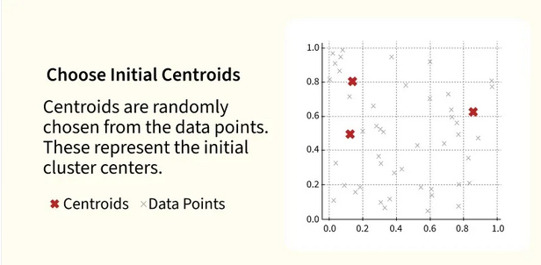
CONTD…
.

Slide 14
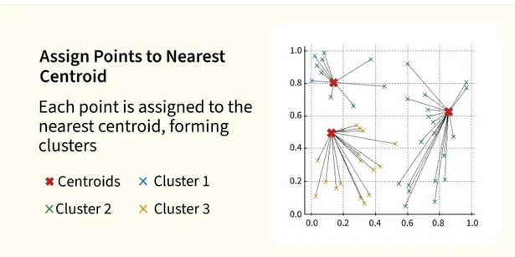
CONTD..

Slide 15
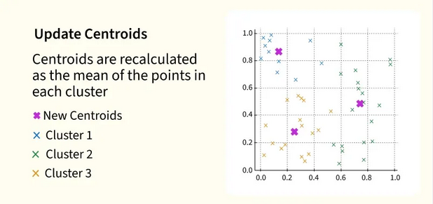
CONTD..

Slide 16
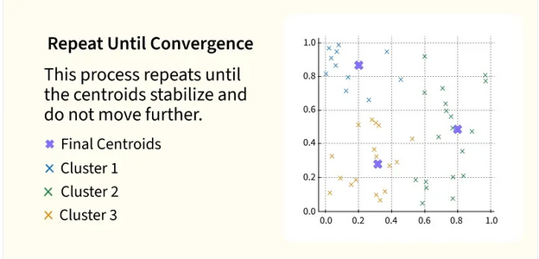
CONTD..

Slide 17
WORKING of K-Means
The algorithm will categorize the items into "kk" groups or clusters of similarity. To calculate that similarity we will use the Euclidean distance as a measurement. The algorithm works as follows:
Initialization: We begin by randomly selecting k cluster centroids.
Assignment Step: Each data point is assigned to the nearest centroid, forming clusters.
Update Step: After the assignment, we recalculate the centroid of each cluster by averaging the points within it.
Repeat: This process repeats until the centroids no longer change or the maximum number of iterations is reached.
The goal is to partition the dataset into kk clusters such that data points within each cluster are more similar to each other than to those in other clusters.

Slide 18
APPLICATIONS
K-Means is popular in a wide variety of applications due to its simplicity, efficiency and effectiveness. Here’s why it is widely used:
Data Segmentation: One of the most common uses of K-Means is segmenting data into distinct groups. For example, businesses use K-Means to group customers based on behavior, such as purchasing patterns or website interaction.
Image Compression: K-Means can be used to reduce the complexity of images by grouping similar pixels into clusters, effectively compressing the image. This is useful for image storage and processing.
Anomaly Detection: K-Means can be applied to detect anomalies or outliers by identifying data points that do not belong to any of the clusters.
Document Clustering: In natural language processing (NLP), K-Means is used to group similar documents or articles together. It’s often used in applications like recommendation systems or news categorization.
Organizing Large Datasets: When dealing with large datasets, K-Means can help in organizing the data into smaller, more manageable chunks based on similarities, improving the efficiency of data analysis.

Slide 19
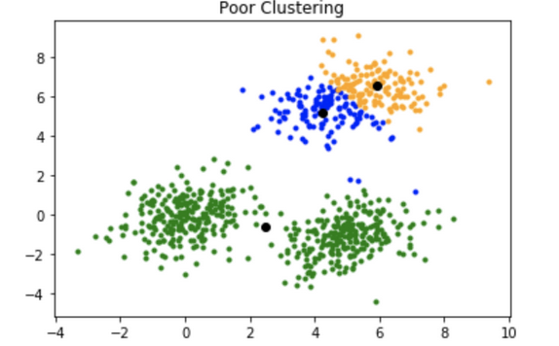
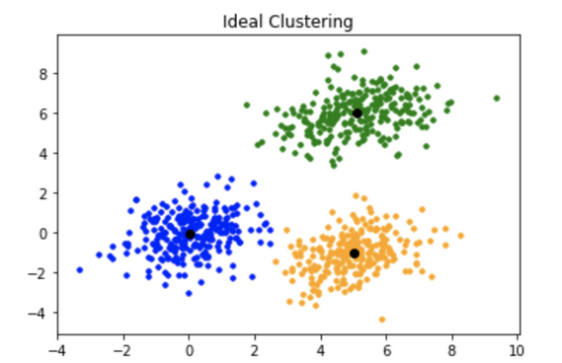
CONTD..

Slide 20
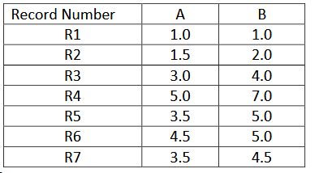
PROBLEM
For the given data, compute two clusters using K-means algorithm for clustering where initial cluster centers are (1.0, 1.0) and (5.0, 7.0). Execute for two iterations.

Slide 21
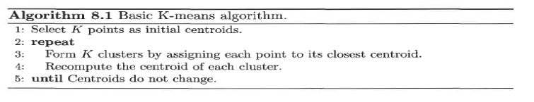
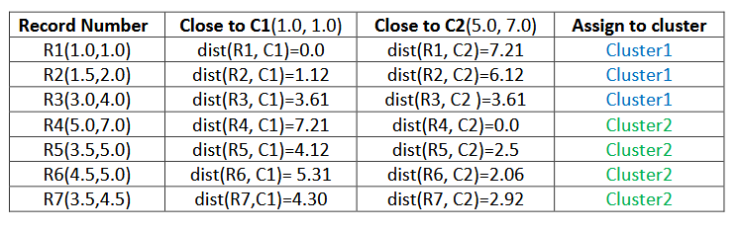
CONTD..
Initialization: Number of clusters (K) = 2, centroid for cluster1 (C1)= (1.0, 1.0) and centroid for cluster2 (C2) = (5.0, 7.0). We use Euclidean distance to find closest point to centroids.

Slide 22
CONTD..
Thus, we obtain two clusters containing:
Cluster1 {R1, R2, R3} and Cluster2 {R4, R5, R6, R7}.
Their new centroids are:
C1 = (1.0+1.5+3.0)/3, (1.0+2.0+4.0)/3
= 5.5/3, 7.0/3
= 1.83, 2.33
C2 = (5.0+3.5+4.5+3.5)/4, (7+5+5+4.5)/4
= 16.5/4, 21.5/4
= 4.12, 5.37

Slide 23
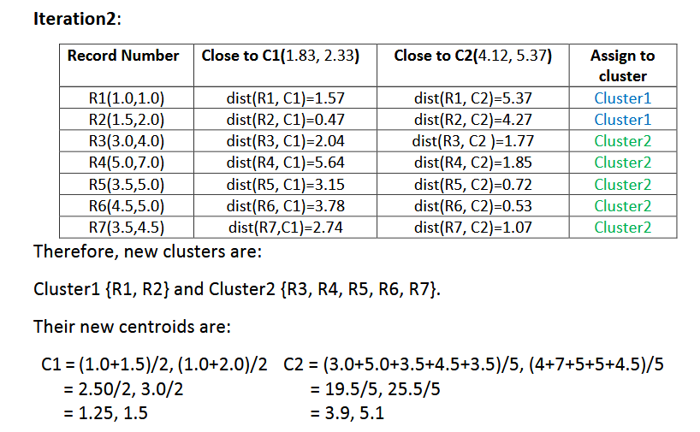
CONTD..

Slide 24
C-means clustering
C-means clustering, or fuzzy c-means clustering, is a soft clustering technique in machine learning in which each data point is separated into different clusters and then assigned a probability score for being in that cluster. Fuzzy c-means clustering often gives better results for overlapped data sets compared to k-means clustering.
Fuzzy clustering is a type of clustering algorithm where each data point can belong to more than one cluster with varying degrees of membership. Unlike traditional clustering (hard clustering), where a point belongs to exactly one cluster, fuzzy clustering assigns a membership value between 0 and 1 for each point's participation in each cluster. This allows more flexible grouping, especially when clusters overlap or data points are ambiguous.

Slide 25
CONTD..
Fuzzy c-means clustering is a soft clustering approach, where each data point is assigned a likelihood or probability score belonging to that cluster. The step-wise approach of the fuzzy c-means clustering algorithm is:
Fix the value of c (number of clusters), and select a value of m (generally 1.25<m<2), and initialize partition matrix U.
C-Means Advantages:
Fuzzy c-means clustering can be considered a better algorithm compared to the k-means algorithm. Unlike the k-means algorithm, where the data points exclusively belong to one cluster, data points in the fuzzy c-means algorithm can belong to more than one cluster with a likelihood. As a result, fuzzy c-means clustering gives comparatively better results for overlapped data sets.

Slide 26
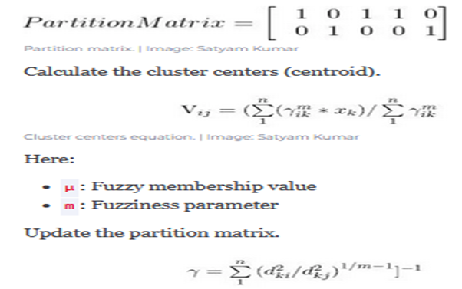
CONTd..

Slide 27
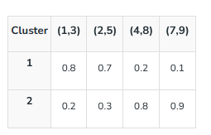
Working of Fuzzy Clustering
Fuzzy clustering follows an iterative optimization process where data points are assigned membership values instead of hard cluster labels. Here’s a step-by-step breakdown of how it works:
Step 1: Initialize Membership Values Randomly: Each data point is assigned initial membership degrees for all clusters. These values represent the likelihood of the point belonging to each cluster. Unlike hard clustering, a point can partially belong to multiple clusters simultaneously.
For example, for 2 clusters and 4 data points, an initial membership matrix (γ) might look like:

Slide 28

CONTD..
Step 2: Compute Cluster Centroids: Cluster centroids are calculated as the weighted average of all data points, where weights are the membership values raised to the fuzziness parameter m. Points with higher membership influence centroids more.
The centroid coordinate vij​ for cluster ii and feature j is:

Slide 29
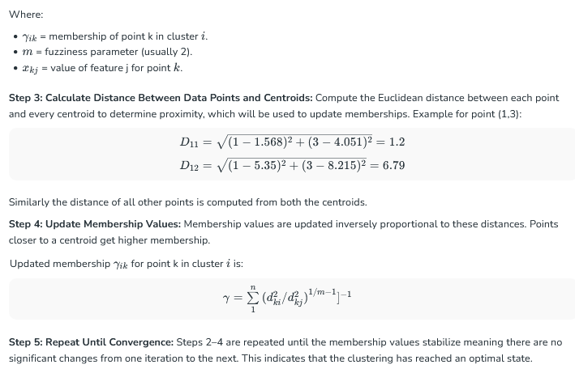
CONTD..

Slide 30
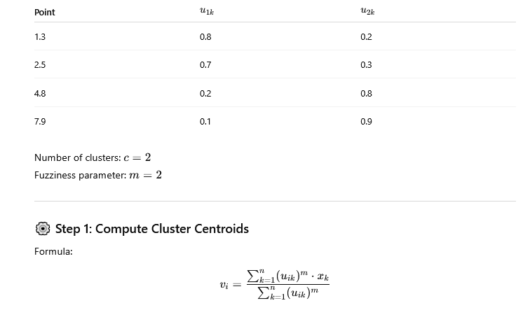

Slide 31
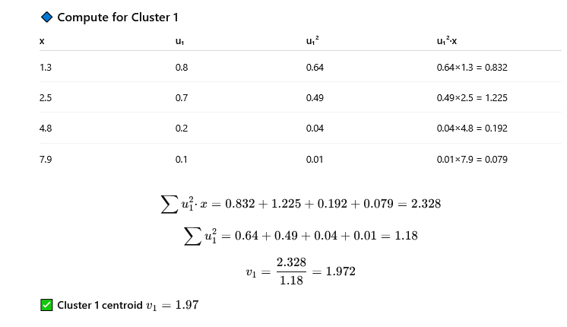

Slide 32
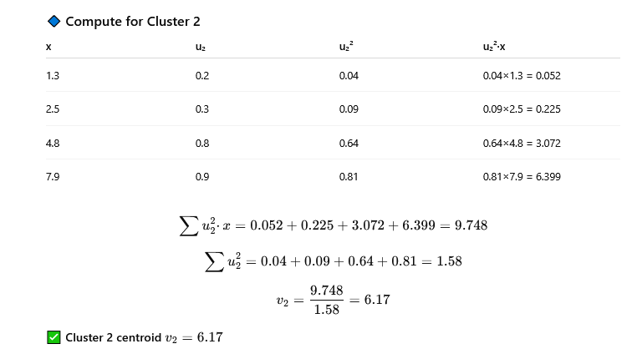

Slide 33
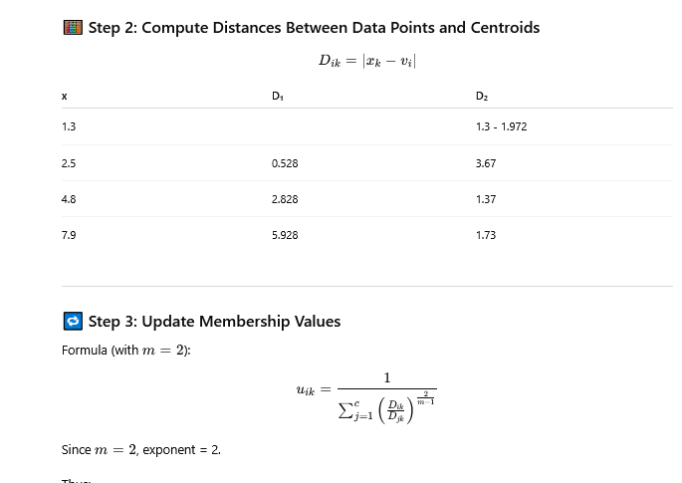

Slide 34
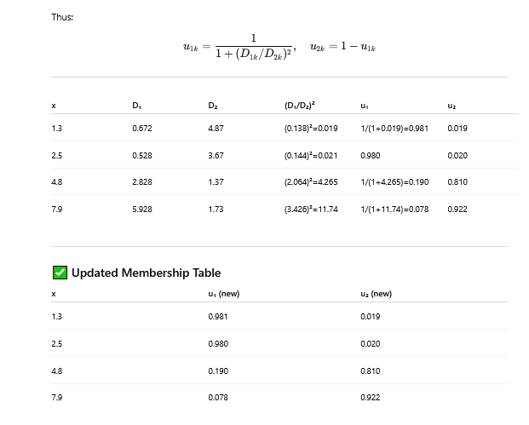

Slide 35
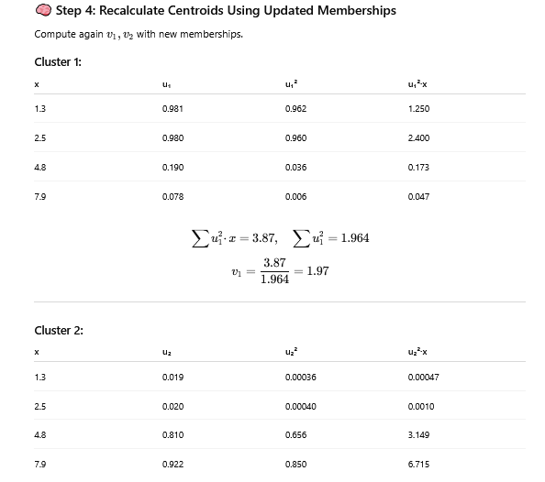

Slide 36
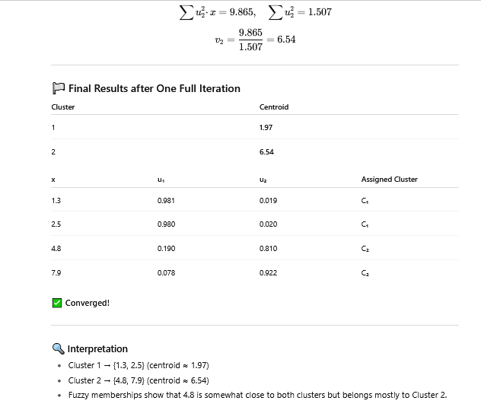

Slide 37
Self-Assessment Questions
1. Clustering: K-means, C-means,
Number of dimensions in the dataset
Number of nearest neighbors
Number of clusters
Number of iterations
What is the main difference between K-means and Fuzzy C-means?
K-means assigns soft membership, while Fuzzy C-means assigns hard membership
K-means assigns hard membership, while Fuzzy C-means assigns soft membership
Both assign hard membership d)None

Slide 38
TERMINAL QUESTIONS
1. Define clustering and distinguish it from classification.
2. What is the role of the parameter K in K-means clustering?
3. Mention one major limitation of K-means clustering.

Slide 39
REFERENCES FOR FURTHER LEARNING OF THE SESSION
Books:
1ain, A. K., & Dubes, R. C. (1988). Algorithms for Clustering Data. Prentice Hall.
A foundational book focusing entirely on clustering methods.
2. Han, J., Kamber, M., & Pei, J. (2011). Data Mining: Concepts and Techniques (3rd Edition). Morgan Kaufmann.
Web references:
Scikit-learn Documentation
https://scikit-learn.org/stable/modules/clustering.html
Towards Data Science (Medium)
https://towardsdatascience.com/

Slide 40
THANK YOU
Team – AI &ML

